Slide 1
Building Java Programs
Chapter 14
Lecture Q-1: stacks and queues
reading: 14.1-14.4

Slide 2
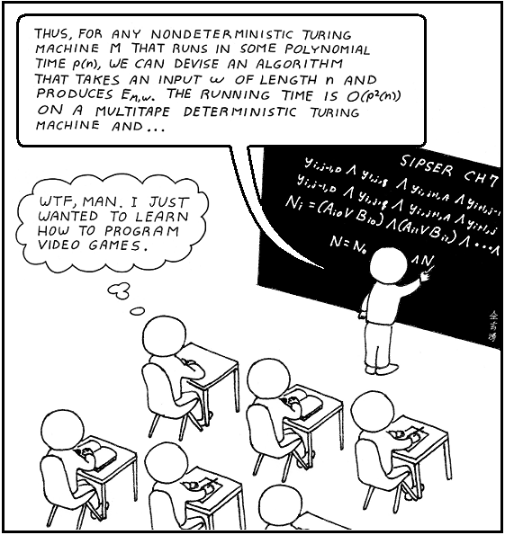

Slide 3
Runtime Efficiency (13.2)
efficiency: measure of computing resources used by code.
  can be relative to speed (time), memory (space), etc.
  most commonly refers to run time
Assume the following:
  Any single Java statement takes same amount of time to run.
  A method call's runtime is measured by the total of the statements inside the method's body.
  A loop's runtime, if the loop repeats N times, is N times the runtime of the statements in its body.

Slide 4
Collection efficiency
Efficiency of our ArrayIntList or Java's ArrayList:
Which operations should we try to avoid?
Method | ArrayList
add(value)
add(index value)
indexOf(value)
get(index)
remove(index)
set(index, value)
size
Method | ArrayList
add(value) | O(1)
add(index value) | O(N)
indexOf(value) | O(N)
get(index) | O(1)
remove(index) | O(N)
set(index, value) | O(1)
size | O(1)

Slide 5
Stacks and queues
Some collections are constrained so clients can only use optimized operations
  stack: retrieves elements in reverse order as added
  queue: retrieves elements in same order as added
push
pop, peek
top | 3
 | 2
bottom | 1
front |  | back
1 | 2 | 3
remove, peek
add
queue
stack

Slide 6
Abstract data types (ADTs)
abstract data type (ADT): A specification of a collection of data and the operations that can be performed on it.
  Describes what a collection does, not how it does it
We don't know exactly how a stack or queue is implemented, and we don't need to.
  We just need to understand the idea of the collection and what operations it can perform.
  (Stacks are usually implemented with arrays; queues are often implemented using another structure called a linked list.)

Slide 7
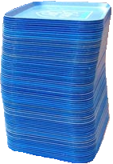
Stacks
stack: A collection based on the principle of adding elements and retrieving them in the opposite order.
  Last-In, First-Out ("LIFO")
  Elements are stored in order of insertion.
    We do not think of them as having indexes.
  Client can only add/remove/examine
  the last element added (the "top").
basic stack operations:
  push: Add an element to the top.
  pop: Remove the top element.
  peek: Examine the top element.
push
pop, peek
top | 3
 | 2
bottom | 1
stack
Notes:
analogy: trays of food at the sizzler

Slide 8
Stacks in computer science
Programming languages and compilers:
  method calls are placed onto a stack (call=push, return=pop)
  compilers use stacks to evaluate expressions
Matching up related pairs of things:
  find out whether a string is a palindrome
  examine a file to see if its braces { } match
  convert "infix" expressions to pre/postfix
Sophisticated algorithms:
  searching through a maze with "backtracking"
  many programs use an "undo stack" of previous operations
method3 | return var local vars parameters
method2 | return var local vars parameters
method1 | return var local vars parameters

Slide 9
Class Stack
  Stack<String> s = new Stack<String>();
  s.push("a");
  s.push("b");
  s.push("c"); // bottom ["a", "b", "c"] top
  System.out.println(s.pop()); // "c"
  Stack has other methods that are off-limits (not efficient)
Stack<E>() | constructs a new stack with elements of type E
push(value) | places given value on top of stack
pop() | removes top value from stack and returns it; throws EmptyStackException if stack is empty
peek() | returns top value from stack without removing it; throws EmptyStackException if stack is empty
size() | returns number of elements in stack
isEmpty() | returns true if stack has no elements

Slide 10
Collections of primitives
The type parameter specified when creating a collection (e.g. ArrayList, Stack, Queue) must be an object type
  // illegal -- int cannot be a type parameter
  Stack<int> s = new Stack<int>();
  ArrayList<int> list = new ArrayList<int>();
Primitive types need to be "wrapped" in objects
  // creates a stack of ints
  Stack<Integer> s = new Stack<Integer>();

Slide 11
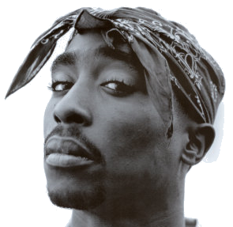
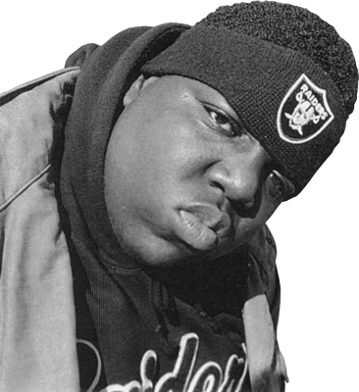
Wrapper classes
Primitive Type | Wrapper Type
int | Integer
double | Double
char | Character
boolean | Boolean
Wrapper objects have a single field of a primitive type
The collection can be used with familiar primitives:
  ArrayList<Double> grades = new ArrayList<Double>();
  grades.add(3.2);
  grades.add(2.7);
  ...
  double myGrade = grades.get(0);

Slide 12
Stack limitations/idioms
You cannot loop over a stack in the usual way.
  Stack<Integer> s = new Stack<Integer>();
  ...
  for (int i = 0; i < s.size(); i++) {
  do something with s.get(i);
  }
Instead, you pull elements out of the stack one at a time.
  common idiom: Pop each element until the stack is empty.
  // process (and destroy) an entire stack
  while (!s.isEmpty()) {
  do something with s.pop();
  }

Slide 13
What happened to my stack?
Suppose we're asked to write a method max that accepts a Stack of integers and returns the largest integer in the stack:
  // Precondition: !s.isEmpty()
  public static void max(Stack<Integer> s) {
  int maxValue = s.pop();
  while (!s.isEmpty()) {
  int next = s.pop();
  maxValue = Math.max(maxValue, next);
  }
  return maxValue;
  }
  The algorithm is correct, but what is wrong with the code?

Slide 14
What happened to my stack?
The code destroys the stack in figuring out its answer.
  To fix this, you must save and restore the stack's contents:
  public static void max(Stack<Integer> s) {
  Stack<Integer> backup = new Stack<Integer>();
  int maxValue = s.pop();
  backup.push(maxValue);
  while (!s.isEmpty()) {
  int next = s.pop();
  backup.push(next);
  maxValue = Math.max(maxValue, next);
  }
  while (!backup.isEmpty()) { // restore
  s.push(backup.pop());
  }
  return maxValue;
  }

Slide 15
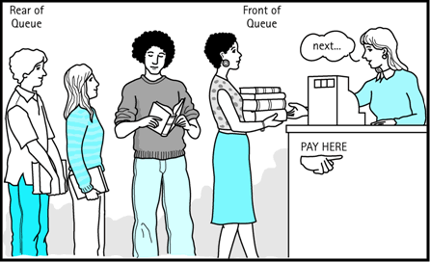
Queues
queue: Retrieves elements in the order they were added.
  First-In, First-Out ("FIFO")
  Elements are stored in order of
  insertion but don't have indexes.
  Client can only add to the end of the
  queue, and can only examine/remove
  the front of the queue.
basic queue operations:
  add (enqueue): Add an element to the back.
  remove (dequeue): Remove the front element.
  peek: Examine the front element.
front |  | back
1 | 2 | 3
remove, peek
add
queue
Notes:
analogy: trays of food at the sizzler

Slide 16
Queues in computer science
Operating systems:
  queue of print jobs to send to the printer
  queue of programs / processes to be run
  queue of network data packets to send
Programming:
  modeling a line of customers or clients
  storing a queue of computations to be performed in order
Real world examples:
  people on an escalator or waiting in a line
  cars at a gas station (or on an assembly line)

Slide 17
Programming with Queues
add(value) | places given value at back of queue
remove() | removes value from front of queue and returns it; throws a NoSuchElementException if queue is empty
peek() | returns front value from queue without removing it; returns null if queue is empty
size() | returns number of elements in queue
isEmpty() | returns true if queue has no elements
  Queue<Integer> q = new LinkedList<Integer>();
  q.add(42);
  q.add(-3);
  q.add(17); // front [42, -3, 17] back
  System.out.println(q.remove()); // 42
  IMPORTANT: When constructing a queue you must use a new LinkedList object instead of a new Queue object.
    This has to do with a topic we'll discuss later called interfaces.

Slide 18
Queue idioms
As with stacks, must pull contents out of queue to view them.
  // process (and destroy) an entire queue
  while (!q.isEmpty()) {
  do something with q.remove();
  }
  another idiom: Examining each element exactly once.
  int size = q.size();
  for (int i = 0; i < size; i++) {
  do something with q.remove();
  (including possibly re-adding it to the queue)
  }
    Why do we need the size variable?

Slide 19
Mixing stacks and queues
We often mix stacks and queues to achieve certain effects.
  Example: Reverse the order of the elements of a queue.
  Queue<Integer> q = new LinkedList<Integer>();
  q.add(1);
  q.add(2);
  q.add(3); // [1, 2, 3]
  Stack<Integer> s = new Stack<Integer>();
  while (!q.isEmpty()) { // Q -> S
  s.push(q.remove());
  }
  while (!s.isEmpty()) { // S -> Q
  q.add(s.pop());
  }
  System.out.println(q); // [3, 2, 1]

Slide 20
Exercises
Write a method stutter that accepts a queue of integers as a parameter and replaces every element of the queue with two copies of that element.
  front [1, 2, 3] back
  becomes
  front [1, 1, 2, 2, 3, 3] back
Write a method mirror that accepts a queue of strings as a parameter and appends the queue's contents to itself in reverse order.
  front [a, b, c] back
  becomes
  front [a, b, c, c, b, a] back

